Slide 1
DBMS Ethnic Wear Project
Anil Kumar Mammula
AF0366923
Under the guidance of
Manali Patil

Slide 2
Abstract
This analysis explores the characteristics and trends within the "ethnic wear" market, focusing on various aspects such as ratings, discounts, main categories, and sub-categories. Utilizing a dataset containing information on product names, main categories, sub-categories, images, links, ratings, number of ratings, discount prices, and actual prices, we conducted a comprehensive analysis.
We began by examining the distribution of ratings across different main categories, revealing variations in customer satisfaction levels within each category. Additionally, we identified the top sub-categories based on average ratings, providing insights into the most positively rated ethnic wear products. Furthermore, we explored the relationship between the number of ratings and discount percentages, shedding light on customer engagement levels in response to discount offers.
Through visualizations including histograms, boxplots, bar charts, and scatter plots, we uncovered valuable insights into customer preferences, market dynamics, and promotional strategies within the ethnic wear market. These insights offer actionable guidance for businesses in optimizing product offerings, marketing strategies, and pricing tactics to better meet customer needs and drive success in the ethnic wear industry.

Slide 3
Software Requirements
Database Management System: Choose a suitable DBMS for storing and managing the dataset. Popular options include:
MySQL
SQLite
Microsoft SQL Server
Database Design Tools: If you're designing a database schema, tools like MySQL Workbench, Microsoft Visio, or dbdiagram.io can help visualize and design your database schema.
Data Analysis Tools: Software tools for data analysis can be helpful in exploring and understanding your dataset. Options include:
Jupyter Notebook or JupyterLab
Google Colab
Programming Language: You'll likely need a programming language to interact with the database, manipulate data, and perform analysis. Common choices include:
Python (with libraries like pandas, matplotlib, seaborn, and MySQL connector)
SQL (for writing queries directly)

Slide 4
Advantages of project
1. **Data-Driven Decision Making**: Utilizing the dataset, businesses can make informed decisions based on trends, patterns, and insights derived from customer ratings, feedback, and sales data.
2. **Improved Customer Satisfaction**: Analysis of ratings and feedback enables businesses to understand customer preferences, leading to tailored product offerings and enhanced satisfaction, fostering customer loyalty.
3. **Optimized Inventory Management**: By analyzing sales and inventory data, businesses can optimize inventory levels, minimize stockouts, and reduce holding costs, ensuring availability of popular ethnic wear products.
4. **Strategic Marketing Campaigns**: Insights from the dataset empower businesses to develop targeted marketing campaigns, highlighting popular products and offering promotions tailored to customer preferences, driving sales and brand engagement.
 | ReplyForward Add reaction

Slide 5
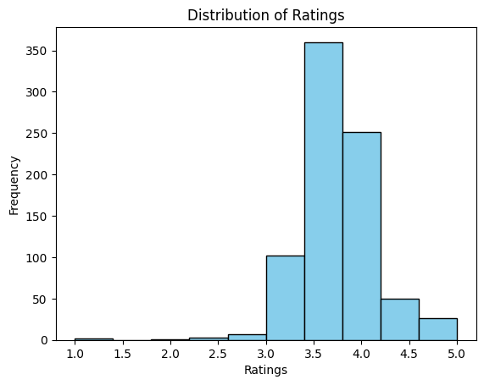
What were the Distribution of Ratings over Ratings by Frequency ?

Slide 6
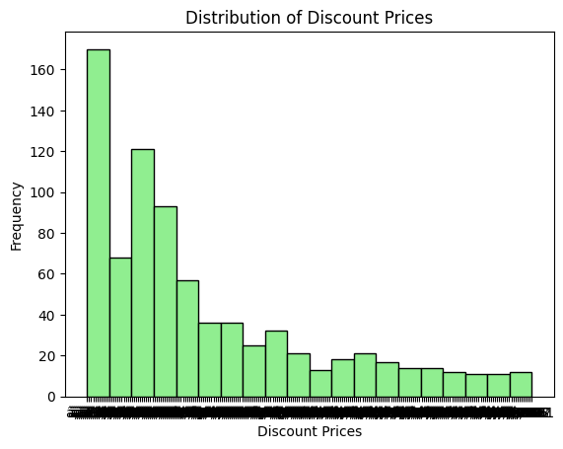
Show the data of Distribution of Discount Prices as with the Discount prices and frequencies?

Slide 7
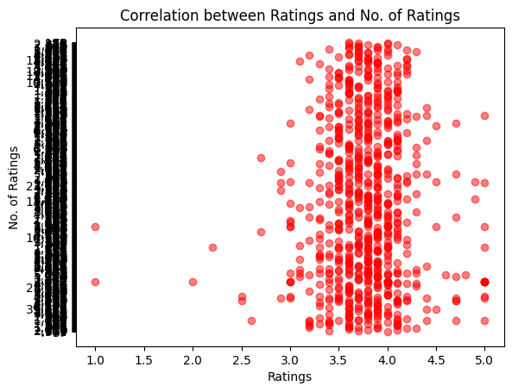
What was the Corrrelation between Ratings and No. of Ratings?

Slide 8
Gantt Chart
Software Development Life Cycle | MARCH 2024
 | 1 | 2 | 3 | 4 | 5 | 6 | 7 | 8 | 9 | 10 | 11 | 12 | 13 | 14 | 15
Project Planning
Gather Requirements
Designing project
Implementation
Testing
Deployment
Maintenance

Slide 9
Future Enhancement
1. **Predictive Analytics**: Implementing predictive analytics models can forecast customer demand, inventory requirements, and sales trends, enabling proactive decision-making and resource allocation.
2. **Personalized Recommendations**: Integrating machine learning algorithms can provide personalized product recommendations based on customer preferences, purchase history, and browsing behavior, enhancing the shopping experience and increasing sales.
3. **Real-time Data Analysis**: Incorporating real-time data processing capabilities allows businesses to monitor sales, inventory levels, and customer feedback in real-time, facilitating timely interventions and adaptive strategies.
4. **Integration with E-commerce Platforms**: Integrating the DBMS with e-commerce platforms enables seamless synchronization of product information, inventory updates, and sales data, streamlining operations and enhancing customer engagement across online channels.

Slide 10
Conclusion
Distribution of Ratings by Main Category: The boxplot visualization shows the distribution of ratings across different main categories of ethnic wear products. We can observe the variation in ratings within each category, indicating differences in customer satisfaction levels.
Top Sub Categories by Average Ratings: This bar chart highlights the top sub categories with the highest average ratings. It provides insights into which specific types of ethnic wear products are most positively rated by customers.
No. of Ratings vs Discount Percentage: The scatter plot illustrates the relationship between the number of ratings received by products and the discount percentage offered. It helps to understand if there's any correlation between the attractiveness of discounts and the level of customer engagement (number of ratings).
In conclusion, by analyzing the distribution of ratings across main categories, identifying top-rated sub categories, and examining the relationship between ratings and discounts, we can gain valuable insights into customer preferences and behaviors within the ethnic wear market. These insights can inform marketing strategies, product assortment decisions, and pricing strategies to better meet customer needs and drive business growth.

Slide 11
Thank You

